Slide 1
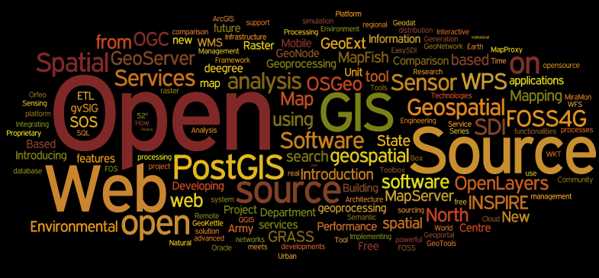
GST 101 - Introduction to Geospatial Technology
Lecture 0 – Getting to Know FOSS and FOSS4G
Created at: wordle.net

Slide 2
What is Open Source Software?
The term refers to how the software is licensed.
Open source software licensed so that:
Everyone can use, copy, study, and change the software in any way
The source code is available everyone
Users are encouraged to voluntarily improve the design and functionality of the software

Slide 3
Proprietary Software
This term also refers to how the software is licensed.
Proprietary software is software licensed so that:
The source code is not available
Use is restricted in some way:
limiting the number of computers it can be installed on
limiting the time period the software can be used
limiting the amount of data that can be processed
limiting the number of features available
limiting the fields of endeavor: educational, non-commercial…

Slide 4
Related Terms
Open Source Software (OSS)?
Free Software (FS)?
FOSS?
What does it all mean?

Slide 5

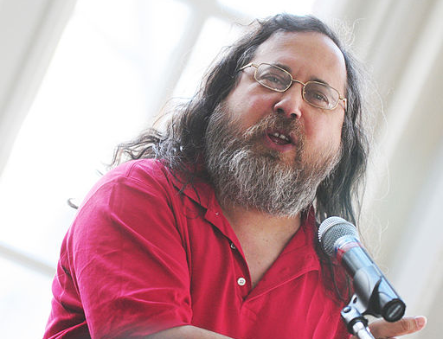
Free Software (FS)
The free software movement was conceived in 1983 by Richard Stallman to give the benefit of "software freedom" to computer users.
Stallman founded the Free Software Foundation in 1985 to provide the organizational structure to advance his Free Software ideas.
CopyLeft - says that anyone who redistributes the software, with or without changes, must pass along the freedom to further copy and change it. CopyLeft guarantees that every user has freedom.
Richard Stallman

Slide 6
Free Software License
“Free" is intended to refer to the freedom to copy and re-use the software, rather than the financial cost of the software.
The Four Kinds of Freedom (for the users of the software)
1) The freedom to run the program, for any purpose.
* 2) The freedom to study how the program works, and adapt it to your needs.
3) The freedom to redistribute copies so you can help your neighbor.
4) The freedom to improve the program, and release your improvements to the public, so that the whole community benefits.
* Requires access to the source code

Slide 7


Open Source Software (OSS)
Eric
Raymond
Coined by Eric Raymond in 1998 who thought the
Term “Free” would be misunderstood.
The source code and certain other rights normally reserved for copyright holders are provided under a software license that meets the Open Source Definition or that is in the public domain.
This license permits users to use, change, and improve the software, and to redistribute it in modified or unmodified forms.

Slide 8
Open source software vs. free software
Open Source Software and Free Software are different terms for software which comes with certain rights, or freedoms, for the user.
They describe two approaches and philosophies towards free software.
They are often described as:
Open Source → a practical development methodology
Free Software → a social movement
Most Open Source software is “free” and
most Free Software is “open source”

Slide 9
FOSS
Many now just use the term:
FOSS = Free and Open Source Software
The term Open Source is much more prevalent in popular culture than FOSS, but software users are beginning to use the FOSS term more frequently.

Slide 10
Other Related Terms
FreeWare – software available at no monetary cost. It is considered neither Free nor Open Source software.
Source Available/Shared Source - source is available for viewing, but it may not legally be modified or redistributed. Has been used by Microsoft.
Closed Source – Most proprietary software.

Slide 11
FOSS Software Projects
FOSS projects are established to solve a particular problem.
Developers then program the software.
FOSS development is not purely altruistic.
Developers often earn a living:
Via selling services provided with the software
Being paid by a third party to develop the software
Being paid via crowd funding
Training others in the use of the software
Selling repackaged software with support agreements

Slide 12
Governance of FOSS Projects
Can be led by one individual – Centralized
or
Can be led by a Steering Committee – Democracy
Steering Committees may include:
Individuals – developers or users
Companies
Organizations

Slide 13
Development Community
In the Open Source development community, any skilled individual can contribute to projects in many ways:
Writing code – development
Testing features & reporting bugs
Writing user manuals
Creating training materials

Slide 14
FOSS vs. Proprietary
Is one better than the other?
The answer is no. FOSS software must be evaluated in the same ways as proprietary software.
The most important question is: “Will it meet my needs?”
To most of us, the availability of source code isn’t the most important factor.
However, the Freedom to use the software is often very attractive.
The lack of licensing fees may also be important.

Slide 15
Software Examples: FOSS vs. Proprietary
FOSS | Proprietary
Operating Systems
Linux | Windows / Mac
Mobile Operating Systems
Android | iOS / Windows Mobile
Office Software
Open Office | Microsoft Office
Image Manipulation
GIMP | Adobe Photoshop
Vector Drawing
Inkscape | Adobe Illustrator
Web Browsers
Chrome/FireFox | Internet Explorer
Web Servers
Apache | IIS
Databases
mySQL | Oracle
PostgreSQL | SQL Server
Statistics
R | S

Slide 16
GIS Software: FOSS vs. Proprietary
FOSS | Proprietary
GeoSpatial Desktop
QGIS | ArcGIS
MapWindow | MapInfo
gvSIG | Manifold GIS
GRASS GIS | IDRISI
uDig | Intergraph
Field GIS
BeeGIS / Geopaparazzi | ArcPAD
Remote Sensing
OSSIM | ERDAS
GRASS GIS | ENVI
Web Mapping
MapServer | ArcIMS
MapGuide | MapGuide
GeoServer | ArcGIS Server
Spatial Databases
SpatiaLite | ESRI File Geodatabase
PostGIS | ArcSDE

Slide 17

FOSS4G
Free and open source software for geospatial.
An acronym used for all geospatial FOSS software.
In this course you will be using the leading FOSS4G desktop software: QGIS.
Notes:
1717

Slide 18
Why Use Open Source for GIS?
It’s free to try.
GIS is a tool – why not have a full toolbox?
Increase your marketability by learning a new skill set.
Eliminate licensing fees.
QGIS will run on multiple operating systems.
You can have more direct involvement in software development.
Notes:
1818

Slide 19

The Open Source Geospatial Foundation (OSGeo)
Non-profit formed in 2006.
Goal is to support and build the best open source geospatial tools.
Provides financial, organizational and legal support to the broader Free and Open Source geospatial community.
Serves as an independent legal entity to which community members can contribute code, funding and other resources. Maintains these contributions for the public benefit.
Provides a common forum.
http://www.osgeo.org/
Notes:
1919

Slide 20
QGIS
An OsGeo Project
A viewer for common geospatial formats.
An editor for geospatial data.
Has many analysis tools.
Notes:
2020

Slide 21
QGIS
Available for Windows, Mac, Linux, & Android.
Easy intuitive interface
Active Development community:
Rapid development (quick bug fixes and new features)
Many user created tools
Active email listserv
Notes:
2121

Slide 22
FOSS Help Resources
With proprietary software there is often a dedicated support phone number to call.
There is a common misconception that FOSS software has poor support
There is actually very good support.
However, with FOSS software support comes from the community.
Notes:
2222

Slide 23
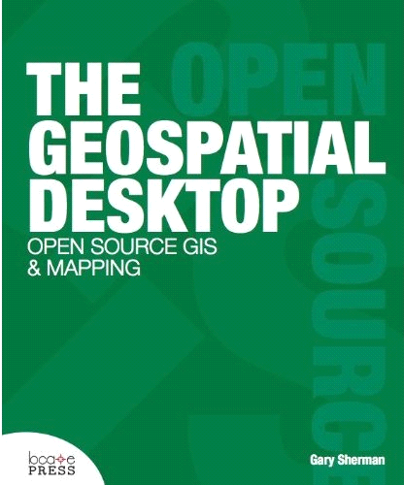
FOSS Help Resources
QGIS has many help resources:
User guide
Case studies
Planet QGIS
Email Listserv
Emails usually answered
within hours
Commercial Support
Conferences / User Groups
Books
Blogs
Social Media
Notes:
2323

Slide 24
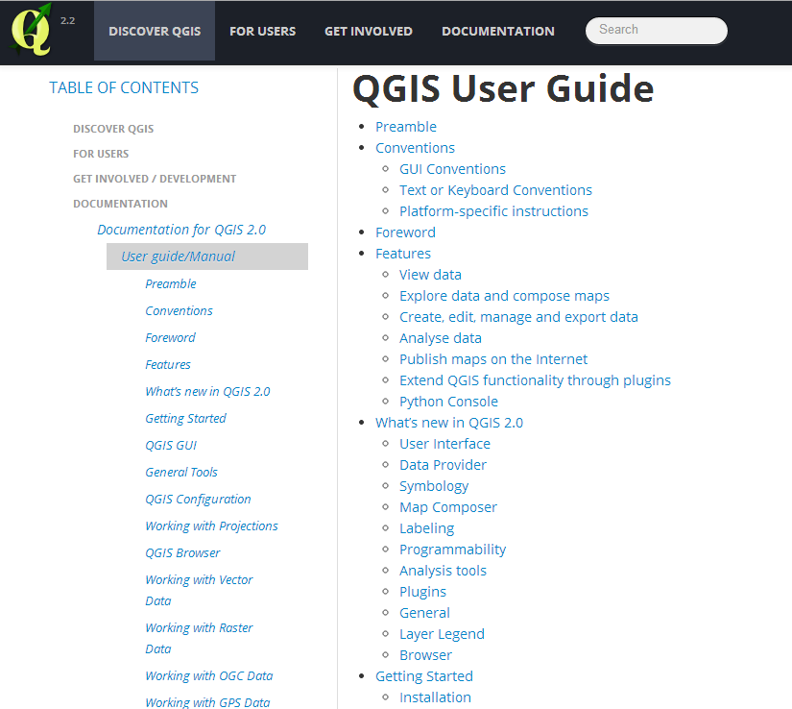
Resources – User Guide
http://www.qgis.org/en/docs/user_manual/index.html
Notes:
2424

Slide 25
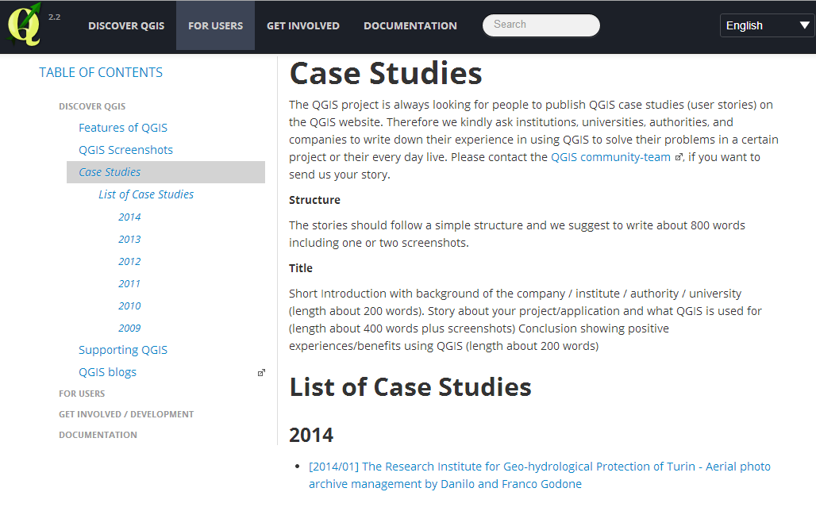
Resources – Case Studies
http://www.qgis.org/en/site/about/case_studies/index.html

Slide 26
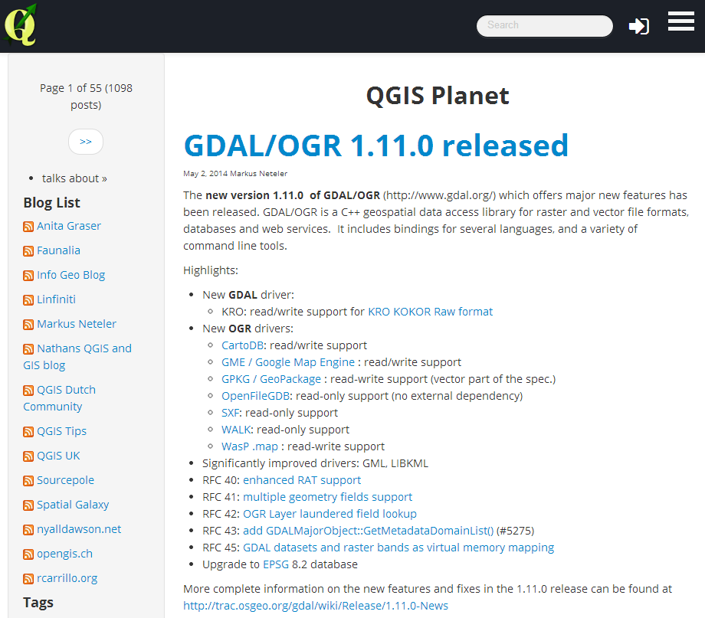
Resources – Planet QGIS
The main QGIS blog
Also includes a blogroll of other QGIS related blogs

